Slide 1

Research skills: INTRODUCTION TO Simulations
Christina Zhou
1/26/24
NOTE: these slides are intended to be self-explanatory and provide younger students an overview of sims at a basic level

Slide 2
Contents
What are simulations and why are they important?
Published paper example
General organization
Useful tools: Github, Cluster
Summarizing Results

Slide 3
The Purpose
Essentially mimic real data based on research question for different purposes
Exploration of different settings
Show theoretic properties
Control/Tweak hyperparameters
Compare to the truth
Big data
Risk free
Cost effective
In a statistics paper, one generally does this before presenting real data analysis and real data analysis results

Slide 4
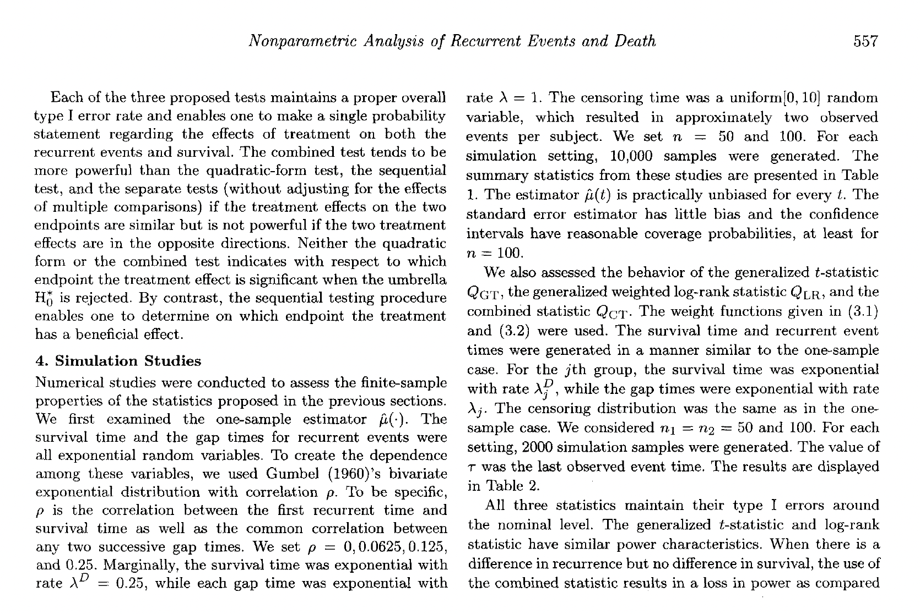
Excerpt From Ghosh & Lin (2000)
Generally, the goal is to find a relevant paper/setting and base your simulation off it
Usually NOT to recreate exactly
Think of it as a starting point aka not something to replicate (unless that is your goal instead)

Slide 5
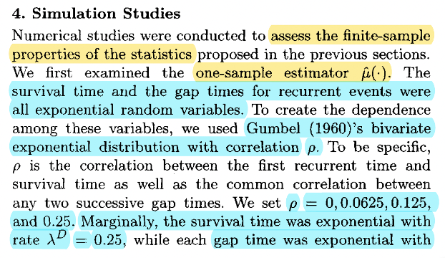
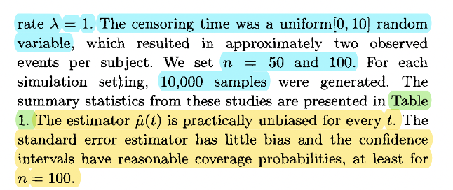
Excerpt From Ghosh & Lin (2000)
set.seed(seed1)
### insert code for setting parameters/hyperparameters ###
### insert code for simulating covariates z ###
### insert code for simulating treatment A ###
# generating censoring time
if (ctype == 0){cc <- rexp(N,cparam)} # option for exponential distribution
if (ctype == 1){cc <- runif(N,min=0,max=tau)} #uniform distribution (set max = 10 for Ghosh & Lin)
# generating gap time 1 using Gumbel bivariate exponential model
alpha1 = 4*gapparam1; alpha2 = 4*gapparam2
lambda_D = lambda_0D*exp(t(beta_D)%*%z + omega_D * A + A * t(gamma_D) %*% z) # hazard for death
lambda_R = lambda_0R*exp(t(beta_R)%*%z + omega_R * A + A * t(gamma_R) %*% z) # hazard for recurrent event
if (alpha1 == 0){
print("Independence")
tt = rexp(N,lambda_0D*exp(t(beta_D)*z))
} else{
print("============== Gumbel Bivariate Exponential ==============")
# generate first gap time using marginal exp(lamR) distribution
gaptime1 = rexp(N,lambda_R)
# generate conditional failure time (given gaptime1)
tt <- as.numeric(GumbelBiExp(N=N,lambda_D=lambda_D,lambda_R=lambda_R,alpha=alpha1,y_type=1,y=gaptime1)$tt)
### good idea for a personal check: insert code to check if times make sense and are generated correctly ###
# Generate G conditional gaptime values for each subject
if (G>1){
gaptimes <- generate_gaptime(N, lambda_D, lambda_R, alpha2, G);
gaptimes[,1] = gaptime1
gap_names <- paste0("gaptime", 1:ncol(gaptimes))
colnames(gaptimes) <- gap_names
} else if (G==1){
gaptimes = gaptime1 %>% as.data.frame()
colnames(gaptimes) = "gaptime1"
}
### insert code for manipulating data format into the style you want for your analysis ###
* not included in slides: GumbelBiExp function that uses property of CDF to generate failure times

Slide 6
sim = gdata_RE(N=N,G=G,lambda_0D=lambda_0D,lambda_0R=lambda_0R,beta_R=beta_R,beta_D=beta_D,omega_D=omega_D,omega_R=omega_R,ztype=ztype,zparam=zparam,ctype=ctype,cparam=cparam,gaptype=gaptype,gapparam1=gapparam1,gapparam2=gapparam2,num_A=num_A,tau=tau,seed1=seed1)
This is for setting up (aka generating data); you also need to create scripts for estimation and evaluation
Tips:
If interested in multiple settings, make use of functions so you can tune parameters
In R, use ”source” function to access other scripts without needing to manually manipulate them directly
Use print, cat, message statements if needed to check in the moment (then comment out after things are all smooth)

Slide 7
Organization Ideas
Everyone does it differently so this is just an overview of mine
Do what works for you but definitely keep it organized because things can get messy/complicated really fast
Simulations Folder
Various Scripts (i.e., F00.Libraries.R, F01.Functions.R, F02.ComparatorFunctions.R, CR00.Parameters.R, CR01.SimulationRun.R, etc)
Output Folder
Figures Folder + Tables Folder

Slide 8
Simple Example (made-up)
General good coding practice: Always vectorize when possible
Text
Corresponding Code
For N = 100 samples, we generate one covariate from the standard normal distribution. We want to take the mean across all samples and see if it’s close to 0. We repeat this for 200 simulations.
n.sim = 200
N = 100
result = data.frame(rep = 1:n.sim, mean = rep(NA,length(n.sim)))
for (sim in 1:n.sim){
set.seed(sim)
Z1 = rnorm(N)
result[sim, "mean"]= mean(Z1) # mean across samples within each simulation
}
View(result)
# take mean across simulations
summary_mean = mean(result[,"mean"])
summary_sd = sd(result[,"mean"])

Slide 9
Useful Tools: UNC Cluster, Github
UNC Cluster (Longleaf/Dogwood)
Computing resource
Automatic submission using bash scripts or R.sys() with sprintf()
UNC has some resources explaining this if you don’t know how to use
Github
Script version control
Git pull/git add ./git commit –m “description”/git push
Set up github repo on both your own machine and the cluster → work on your own R/python → push to the github → pull on the cluster → run the scripts → push to github → pull on local machine → create plots (you could do this on cluster too but I like to do it where its easier to maneuver)

Slide 10
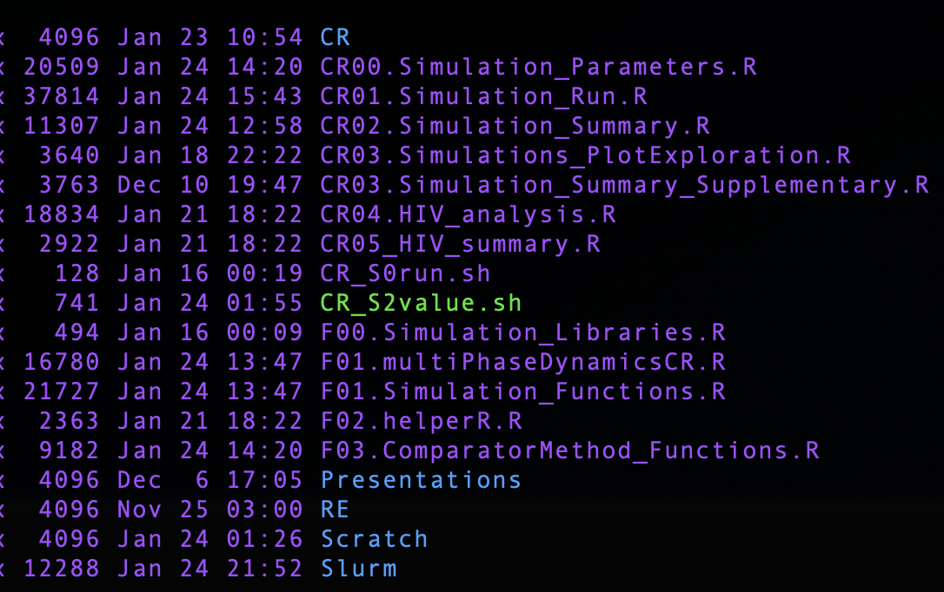
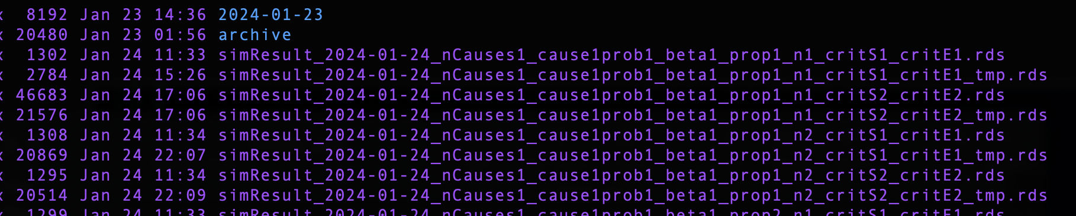
Example Organization
Tips:
Set up automatic script submission using either R or shell – this helps with you have a lot of different parameter settings without having to change a lot of things! Just make sure your file names are appropriately created so they save in a logical manner.
Save all your sims for one setting within one file name
Cluster: make sure you give enough time and memory so that your job doesn’t reach the limit and get automatically cancelled
Run in the background while working on other things

Slide 11
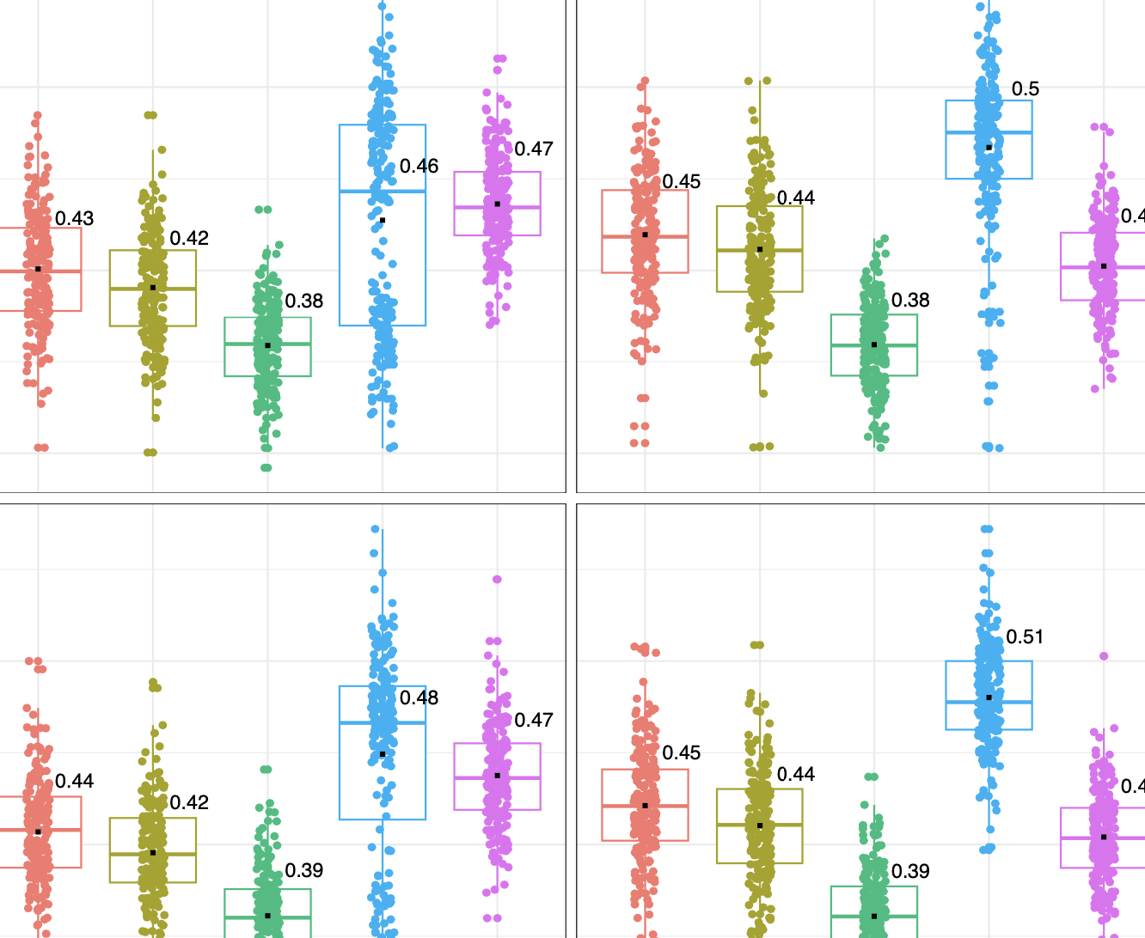
Summary Plots/Tables + Organization
After obtaining results, such as comparing your method to other relevant methods, create summary figures/tables
After rds are all saved on the cluster, you can use ggplot2 in R or matplotlib in Python to generate figures to summarize your results
Again – make sure you stay organized on where things get saved just to make your life easier!

Slide 12
Some Misc Thoughts to Keep in Mind
Sim process almost always take longer than expected (unless you’re lucky or have low expectations)
Really think about your research area and what kinds of situation your method would shine
If X is a CDF of a random variable then CDF of X is uniform
Tuning parameters or doing a grid search/other search might be needed
Be flexible and willing to adapt your code if needed
Simulations are explorative
How you evaluate for your simulation is different than how you evaluate for real data analysis (by nature of simulation vs real data) (testing/training/CV)
Compare your method to other current and relevant methods
Just know everyone gets frustrated at different times so you’re not alone ☺

